Slide 1


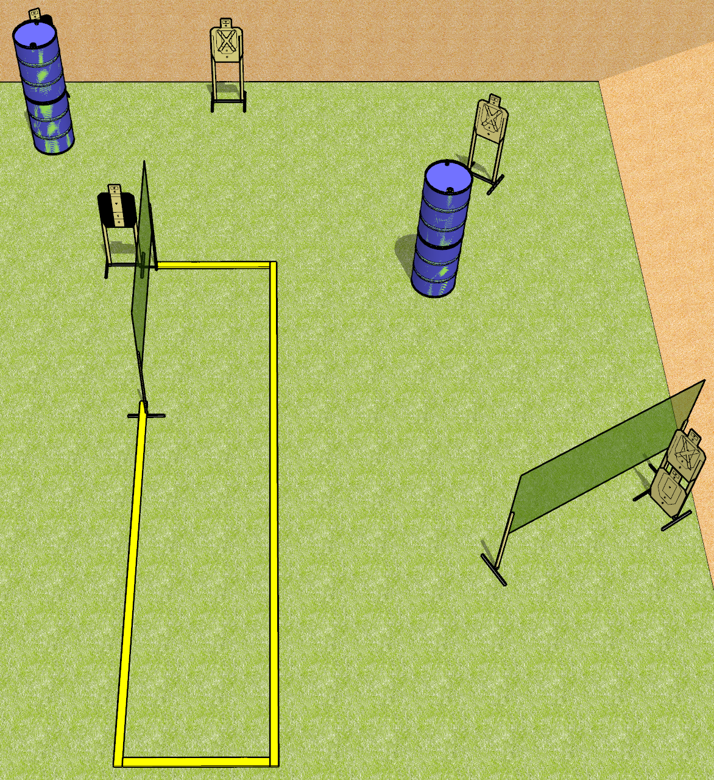
 | Dothan Gun Club – USPSA Match Short and Simple Course Designer : Drew Coleman
START POSITION : Standing with both toes touching rearmost faultline, wrists below belt
GUN READY CONDITION : Pistol loaded and holstered. PCC loaded, buttstock on belt, safety on. |  | SCORING: Comstock, 12 rounds TARGETS: 6 paper, 0 Steel SCORED HITS: Best 2 on paper, steel until down START-STOP: Audible, last shot RULES:
STAGE PROCEDURE: Engage targets as they become available from within the fault lines.

Slide 2
Short and Simple
Written Stage Briefing
Short and Simple is a 12 round, 60 point, Comstock short course. There are six USPSA targets. The best two hits on paper will score. The start signal is audible.
Handgun start position is standing with toes touching the rearmost fault line, outside the shooting area, wrists below belt. Handgun is loaded and holstered
PCC start position start position is standing with toes touching the rearmost fault line, outside the shooting area, buttstock on belt. Loaded carbine is held with both hands, safety on.
On start signal, engage targets from within the shooting area.

